Slide 1
Telerik Testing Framework
Software Quality Assurance
Telerik Software Academy
http://academy.telerik.com

Slide 2

The Lecturer
Dimitar Topuzov
Senior QA Engineer
@NativeScript Team
Email:
Dimitar.Topuzov@Telerik.com

Slide 3

Table of Contents
Telerik Testing Framework Intro
Telerik Testing Framework Features
TTF vs. Test Studio
TTF vs. Selenium WebDriver
Telerik Testing Framework Demos
Testing web sites
Testing WPF applications

Slide 4
Telerik Testing Framework
Free automation framework with .NET API
Support Web (HTML, JavaScript, Ajax, …)
Support Silverlight Applications
Support WPF Applications
Include some nice extras like
Wrappers for Telerik Rad Controls
Build-in handlers for Popups and Browser Dialogs
Element identification using LINQ
VsUnit/NUnit/MbUnit/Xunit templates

Slide 5
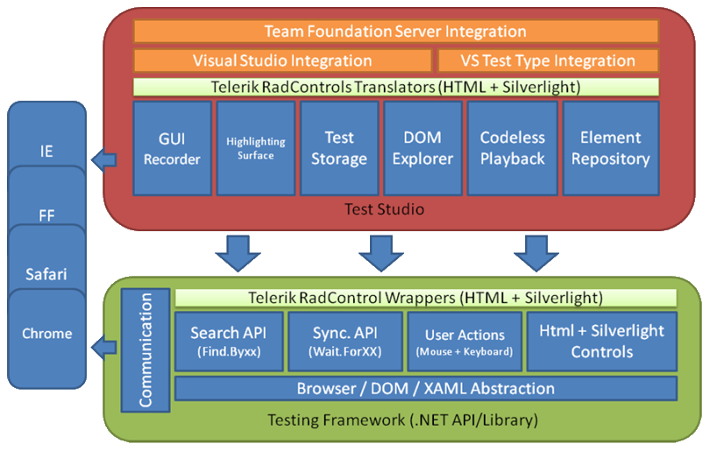
Telerik Testing Framework vs. Test Studio

Slide 6
Telerik Testing Framework vs. Selenium WebDriver
 | Telerik Testing Framework | Selenium WebDriver
Multi-browser support | Yes | Yes
Silverlight | Yes | No
WPF | Yes | No
Language | C#, VB .NET | Java, C#, Python, Ruby, Java Script

Slide 7
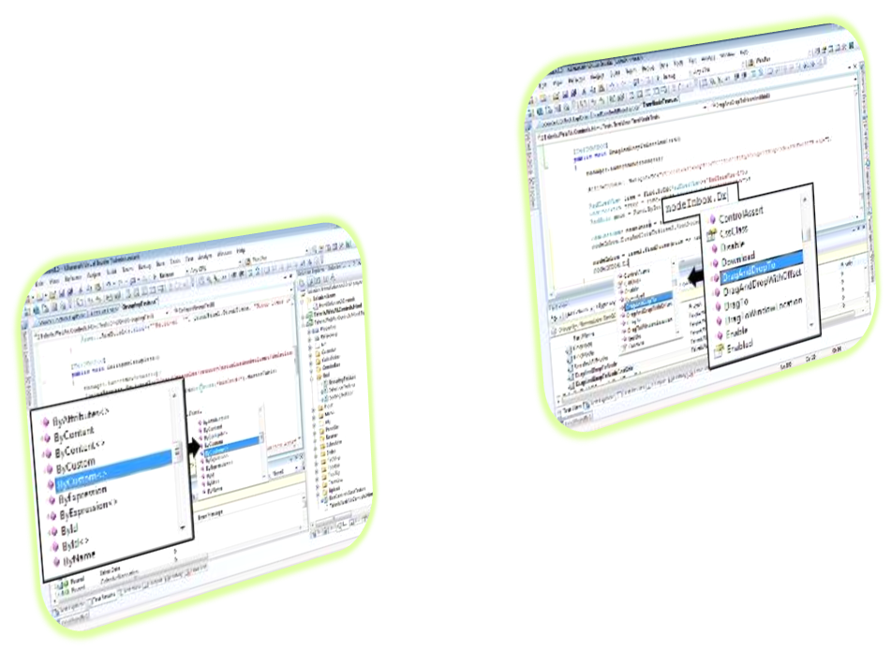
Testing Web and WPF Demos

Slide 8
Telerik Testing Framework
?
?
?
?
?
Questions?
?
?
?
?
?
?

Slide 9




Free Trainings @ Telerik Academy
C# Programming @ Telerik Academy
csharpfundamentals.telerik.com
Telerik Software Academy
academy.telerik.com
Telerik Academy @ Facebook
facebook.com/TelerikAcademy
Telerik Software Academy Forums
forums.academy.telerik.com

